Slide 1
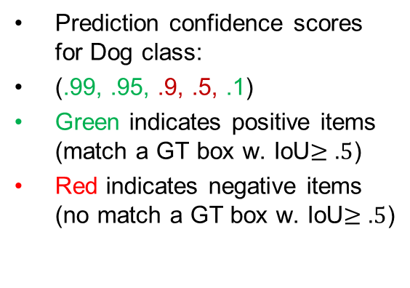
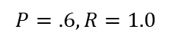
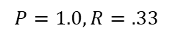
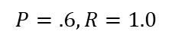
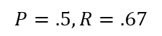
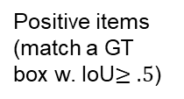
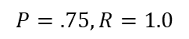
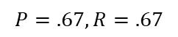
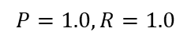
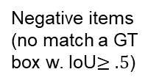
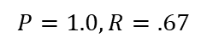
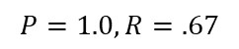
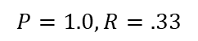
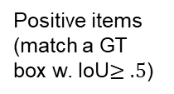
Prediction confidence scores for Dog class:
(.99, .95, .9, .5, .1)
Green indicates positive items (match a GT box w. IoU$≥.5$)
Red indicates negative items (no match a GT box w. IoU$≥.5$)
1.0
Decision
thresh.
Negative items (no match a GT box w. IoU$≥.5$)
Positive items (match a GT box w. IoU$≥.5$)
Precision
TN
TP
FN
FP
Recall
1.0
Pred. Neg. (not Dog)
Score
Pred. Pos. (Dog)
FN=2 | TN=0
TP=1 | FP=0
FN=1 | TN=0
TP=2 | FP=0
FN=1 | TN=0
TP=2 | FP=1
FN=1 | TN=0
TP=2 | FP=2
FN=0 | TN=0
TP=3 | FP=2
$$P=1.0, R=.33$$
$$P=1.0, R=.67$$
$$P=.67, R=.67$$
$$P=.5, R=.67$$
$$P=.6, R=1.0$$
1.0
Decision
thresh.
Prediction confidence scores for Dog class: (.99, .95, .93, .9, .5)
Negative items (no match a GT box w. IoU$≥.5$)
Positive items (match a GT box w. IoU$≥.5$)
Precision
TN
TP
Recall
1.0
Pred. Neg. (not Dog)
Pred. Pos. (Dog)
Score
FN=2 | TN=0
TP=1 | FP=0
FN=1 | TN=0
TP=2 | FP=0
FN=0 | TN=0
TP=3 | FP=0
FN=0 | TN=0
TP=3 | FP=1
FN=0 | TN=0
TP=3 | FP=2
$$P=1.0, R=.33$$
$$P=1.0, R=.67$$
$$P=1.0, R=1.0$$
$$P=.75, R=1.0$$
$$P=.6, R=1.0$$
Notes:
To get the perfect AP = 1.0, we need Precision = $\frac{TP}{TP+FP}=1.0$, Recall = $\frac{TP}{TP+FN}=1.0$, i.e., Hit all $N$ GT boxes with IoU > 0.5, and have no FP detections ranked above any TP

Slide 2
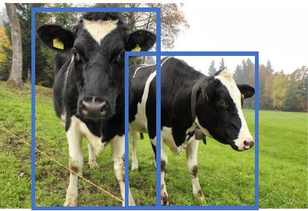
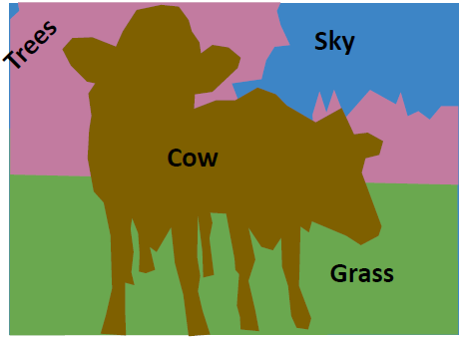
L4 Object Detection and Segmentation
Zonghua Gu 2022
Acknowledgement: Based EECS 498 Deep Learning for Computer Vision, U Michigan

Slide 3
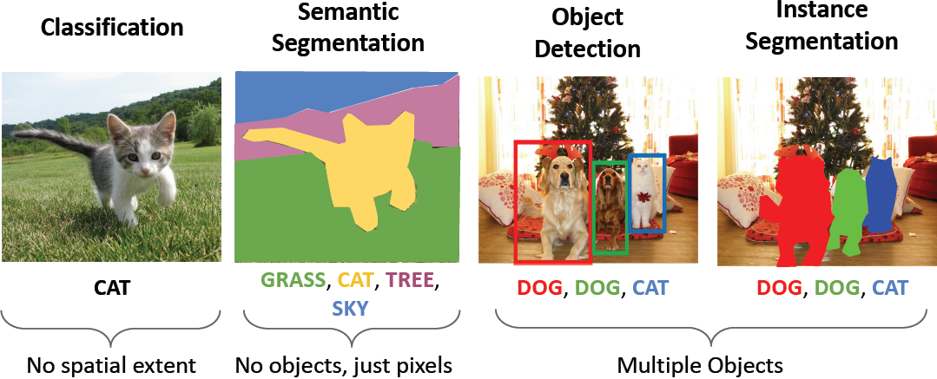
Computer Vision Tasks

Slide 4

Outline
Object detection
Segmentation
https://towardsdatascience.com/object-detection-using-deep-learning-approaches-an-end-to-end-theoretical-perspective-4ca27eee8a9a

Slide 5
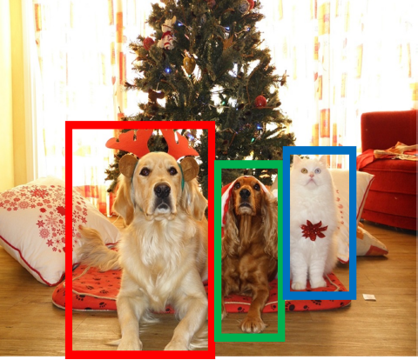
Object Detection: Task Definition
Input: Single Image
Output: a set of detected objects
For each object predict:
1. Class label (e.g., cat vs. dog)
2. Bounding box (4 numbers: x, y, width, height)
Challenges:
Multiple outputs: variable numbers of objects per image
Multiple types of output: predict ”what” (class label) as well as “where” (bounding box)
Large images: Classification works at 224x224 or lower; need higher resolution for detection, often ~800x600

Slide 6
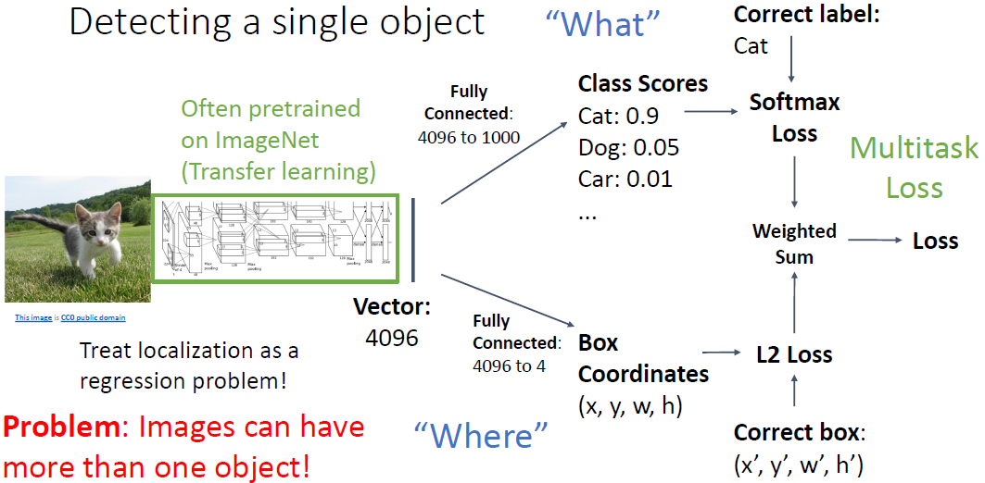
Single-Object Detection

Slide 7
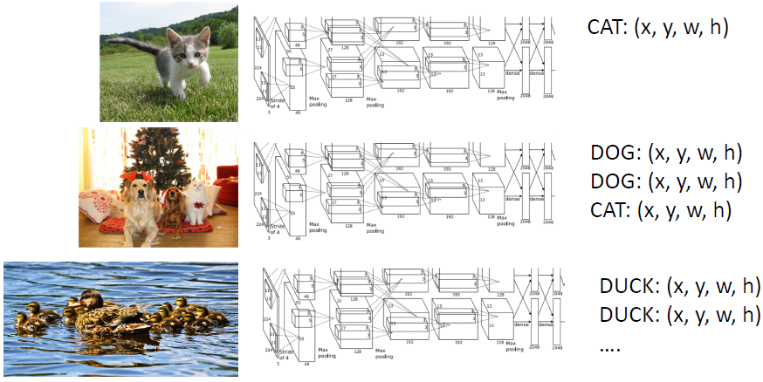
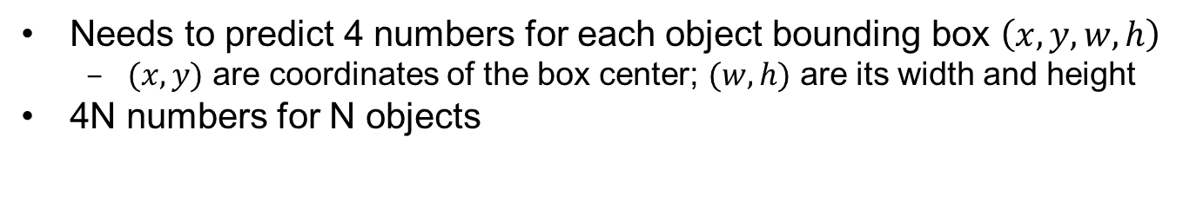
Multi-Object Detection
Needs to predict 4 numbers for each object bounding box $\left(x, y, w, h\right)$
$(x, y)$ are coordinates of the box center; $(w, h)$ are its width and height
4N numbers for N objects

Slide 8
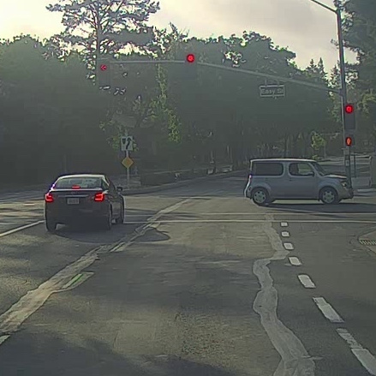
Detecting Multiple Objects: Sliding Window
Slide a box across the image, and apply a CNN to classify each image patch as object or background
https://www.coursera.org/learn/convolutional-neural-networks/lecture/VgyWR/object-detection

Slide 9
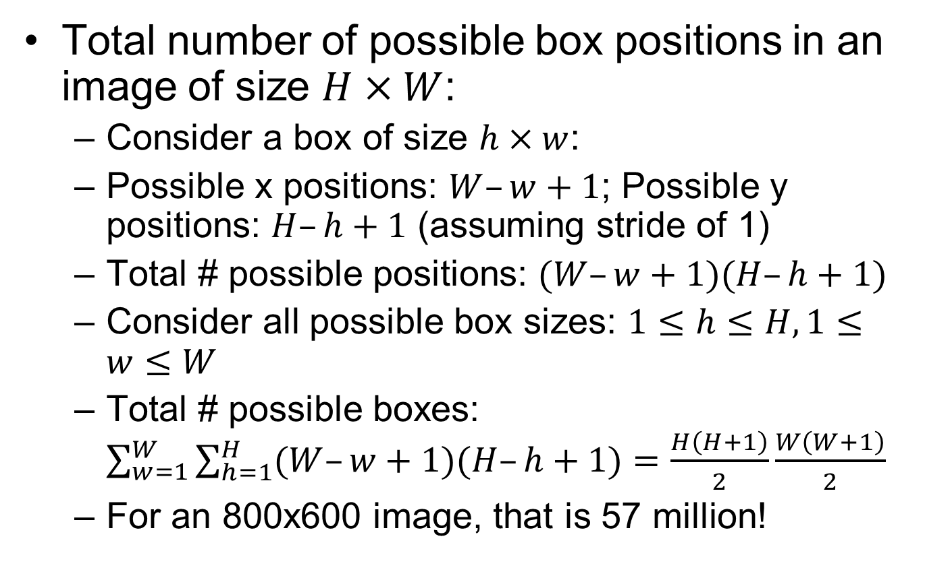
Sliding Window Computational Complexity
Total number of possible box positions in an image of size $H×W$:
Consider a box of size $h×w$:
Possible x positions: $W–w+1$; Possible y positions: $H–h+1$ (assuming stride of 1)
Total # possible positions: $(W–w+1)(H–h+1)$
Consider all possible box sizes: $1≤h≤H,1≤w≤W$
Total # possible boxes: $\sum_{w=1}^{W}{\sum_{h=1}^{H}{(W–w+1)(H–h+1)}}=\frac{H\left(H+1\right)}{2}\frac{W\left(W+1\right)}{2}$
For an 800x600 image, that is 57 million!

Slide 10
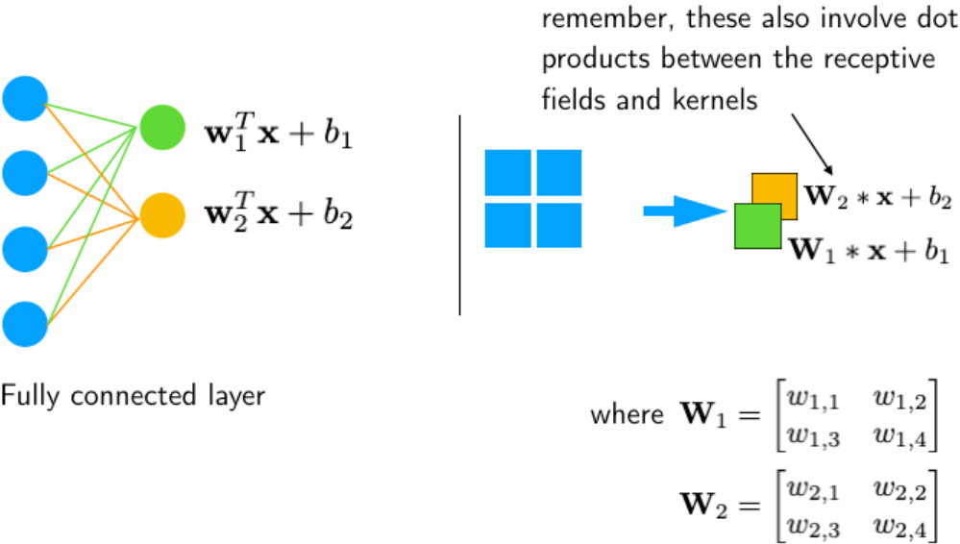
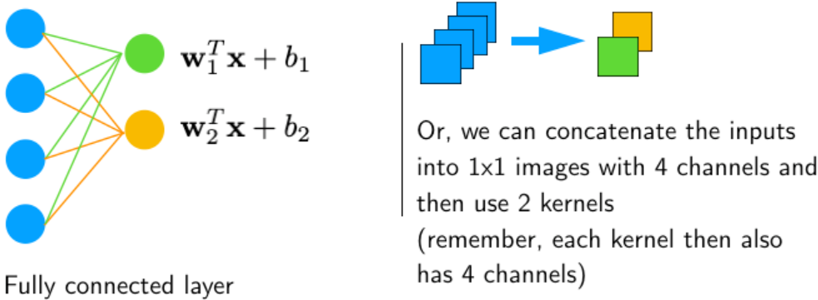
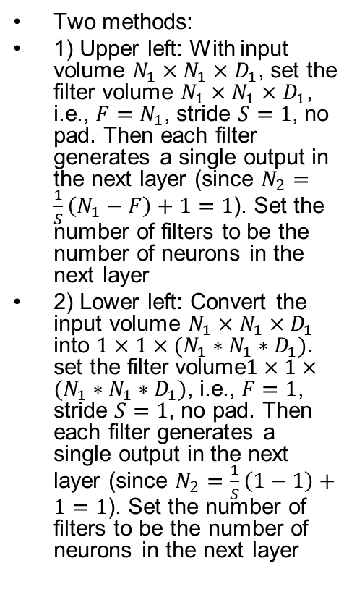
Tuning a FC layer into an equivalent CONV layer
Two methods:
1) Upper left: With input volume $N_{1}×N_{1}×D_{1}$, set the filter volume $N_{1}×N_{1}×D_{1}$, i.e., $F=N_{1}$, stride $S=1$, no pad. Then each filter generates a single output in the next layer (since $N_{2}=\frac{1}{S}\left(N_{1}−F\right)+1=1$). Set the number of filters to be the number of neurons in the next layer
2) Lower left: Convert the input volume $N_{1}×N_{1}×D_{1}$ into $1×1×{(N_{1}∗N_{1}∗D}_{1})$. set the filter volume$1×1×{(N_{1}∗N_{1}∗D}_{1})$, i.e., $F=1$, stride $S=1$, no pad. Then each filter generates a single output in the next layer (since $N_{2}=\frac{1}{S}\left(1−1\right)+1=1$). Set the number of filters to be the number of neurons in the next layer
https://sebastianraschka.com/faq/docs/fc-to-conv.html

Slide 11
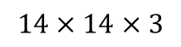
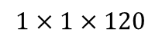
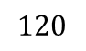
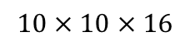
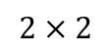
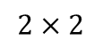
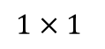
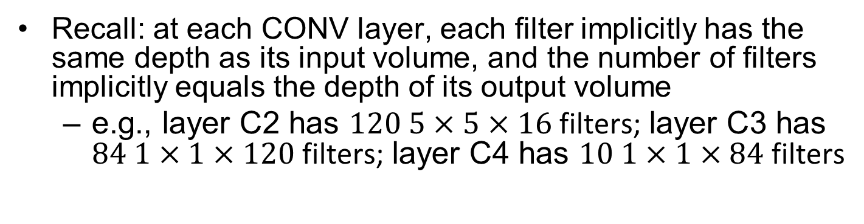
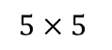
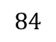
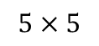
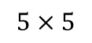
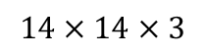
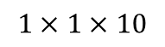
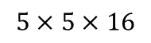
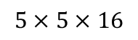
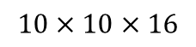
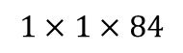
FC-to-CONV Conversion Applied
Recall: at each CONV layer, each filter implicitly has the same depth as its input volume, and the number of filters implicitly equals the depth of its output volume
e.g., layer C2 has $120$ $5×5×16$ filters; layer C3 has $84$ $1×1×120$ filters; layer C4 has $10$ $1×1×84$ filters
C1
MAX POOL
FC
FC
$$5×5$$
$$2×2$$
$$⋮$$
$$⋮$$
y
softmax(10)
$$14×14×3$$
$$10×10×16$$
$$5×5×16$$
$$120$$
$$84$$
C1
MAX POOL
C2
C3
C4
$$5×5$$
$$2×2$$
$$5×5$$
$$1×1$$
$$14×14×3$$
$$10×10×16$$
$$5×5×16$$
$$1×1×120$$
$$1×1×84$$
$$1×1×10$$

Slide 12
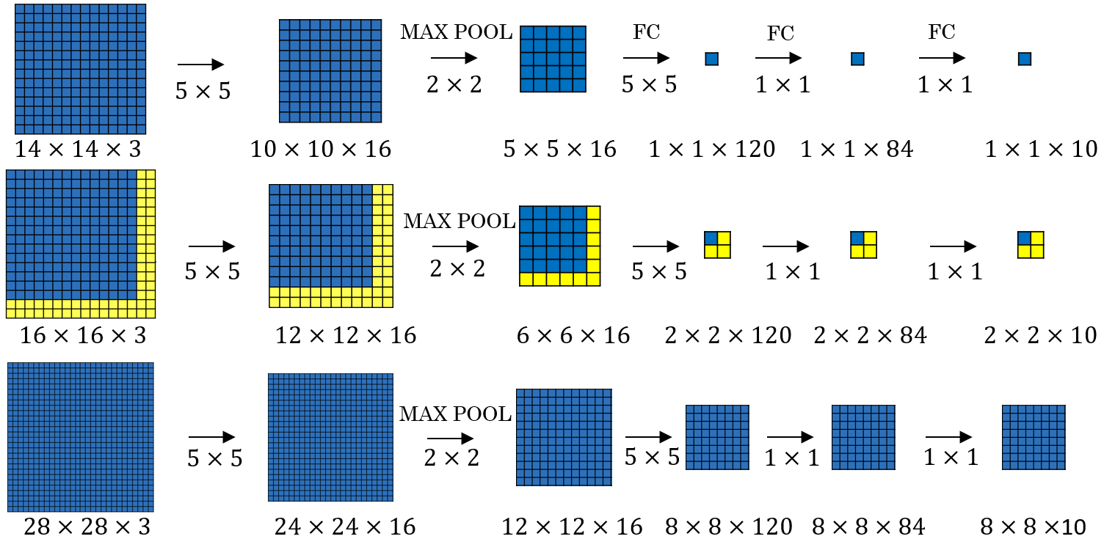
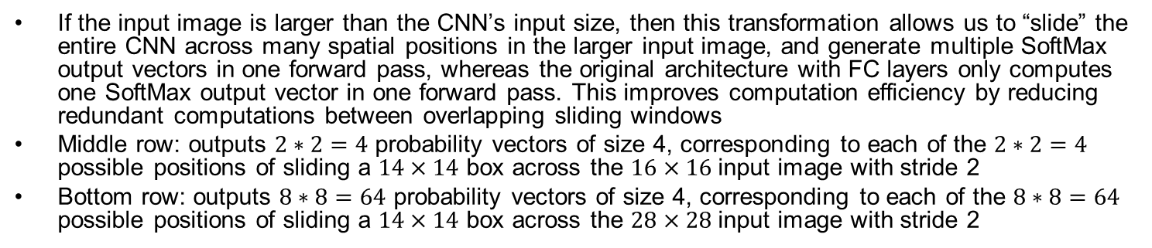
Convolution Implementation of Sliding Windows
If the input image is larger than the CNN’s input size, then this transformation allows us to “slide” the entire CNN across many spatial positions in the larger input image, and generate multiple SoftMax output vectors in one forward pass, whereas the original architecture with FC layers only computes one SoftMax output vector in one forward pass. This improves computation efficiency by reducing redundant computations between overlapping sliding windows
Middle row: outputs $2∗2=4$ probability vectors of size 4, corresponding to each of the $2∗2=4$ possible positions of sliding a $14×14$ box across the $16×16$ input image with stride 2
Bottom row: outputs $8∗8=64$ probability vectors of size 4, corresponding to each of the $8∗8=64$ possible positions of sliding a $14×14$ box across the $28×28$ input image with stride 2

Slide 13
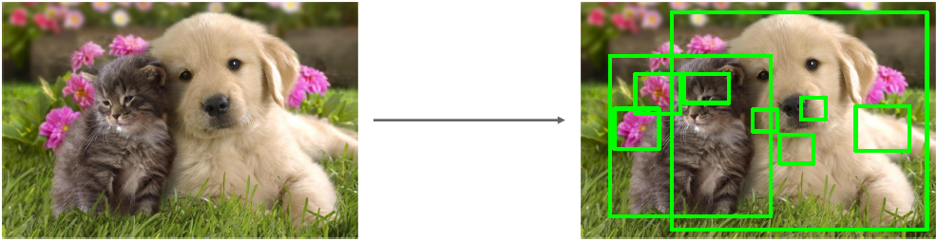
Region Proposals
Generating region proposals: find a small set of boxes that are likely to cover all objects, based on heuristics (no learning): e.g., look for “blob-like” image regions
Relatively fast to run: e.g. Selective Search gives 2000 region proposals in a few seconds on CPU

Slide 14
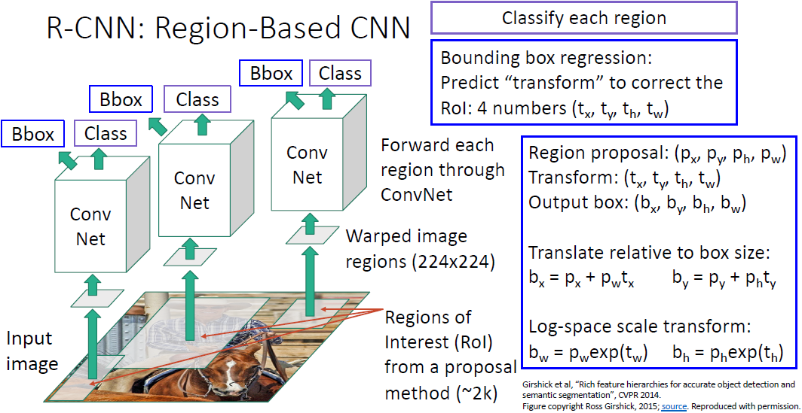
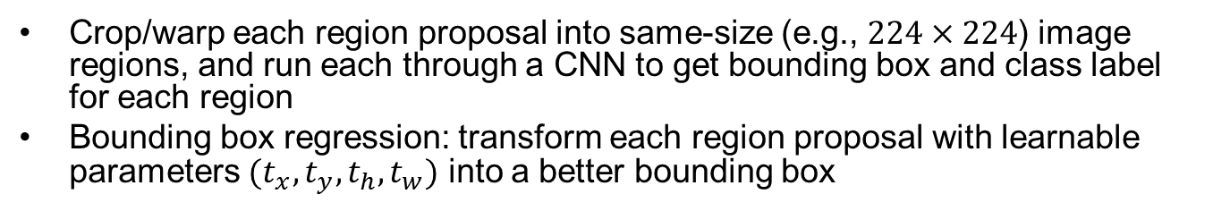
R-CNN: Training Time
Important
Crop/warp each region proposal into same-size (e.g., $224×224$) image regions, and run each through a CNN to get bounding box and class label for each region
Bounding box regression: transform each region proposal with learnable parameters $(t_{x},t_{y},t_{h},t_{w})$ into a better bounding box

Slide 15
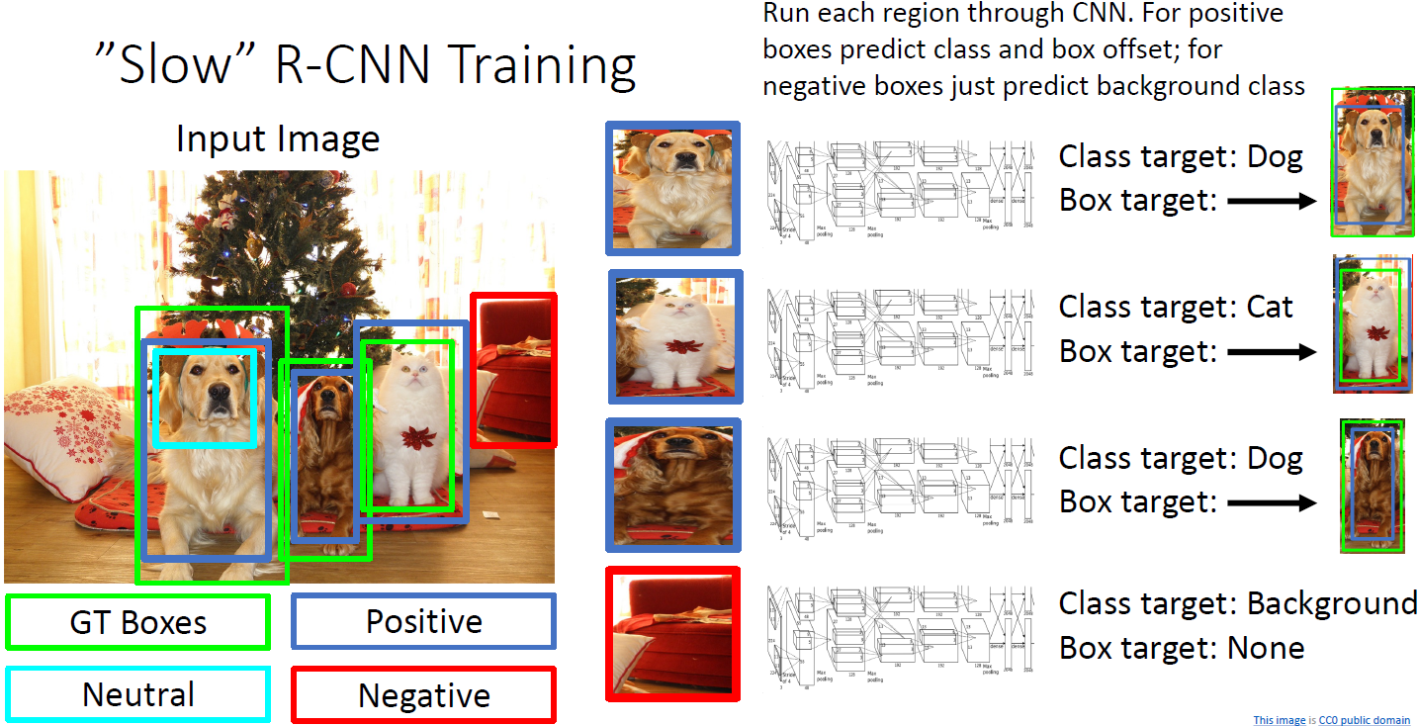
R-CNN Training Example
Categorize each region proposal as positive, negative, or neutral based on overlap with ground-truth boxes
Crop pixels from each positive and negative proposal, resize to 224 x 224
Use the CNN for Bbox regression and classification for positive boxes; only 1-class prediction for negative boxes

Slide 16

R-CNN: Test Time
1. Run region proposal method to compute ~2000 region proposals
2. Resize each region to $224×224$ (tunable hyperparams) and run independently through the CNN to predict class scores and Bbox transform
3. Use scores to select a subset of region proposals to output
Many choices here: threshold on background score (e.g., output bottom K proposals with lowest background scores), or per-class (e.g., output top K proposals with highest classification scores for the given class)…
4. Compare with ground-truth Bboxes
Notes:
Input: Single Image
, Or take top K proposals per image?

Slide 17



Detection Criteria (Intersection Over Union, IOU)
Blue box: Ground Truth; Red box: model output
Set a threshold for detection (positive result) $IOU(B_{GT},B_{Pred})≥θ_{IoU}$
Common threshold $θ_{IoU}=0.5$

Slide 18






Non-Max Suppression (NMS)
NMS discards (suppresses) overlapping object boxes except the one with the maximum classification score
1. For each output class
1.1 Select next highest-scoring box $b$ and output it as a prediction
1.2 Discard any remaining boxes $b′$ with IoU($b,b′$) > threshold
1.3. If any boxes remain, GOTO 1.1
Example:
Assume threshold=.7
Blue box has the highest classification score $P\left(dog\right)=.9$. Output the blue box, and discard the orange box since IoU(blue, orange)=.78>.7.
The next highest-scoring box is the purple box with $P\left(dog\right)=.75$. Output the purple box, and discard the yellow box since IoU(purple, yellow)=.74>.7
Notes:
Problem: Object detectors often output many overlapping detections

Slide 19

Evaluating Object Detectors: Mean Average Precision (mAP)
1. Run object detector on all test images (with NMS)
2. For each class, compute Average Precision (AP)
1. For each detection (highest score to lowest score)
1. If it matches some GT box with IoU > 0.5, mark it as positive and eliminate the GT
2. Otherwise mark it as negative
3. Plot a point on PR Curve
2. Average Precision (AP) for each class, e.g., $AP_{dog}$=AUPRC (Area Under PR Curve) for the dog class
3. mean Average Precision (mAP) = average of APs for each class
4. For “COCO mAP”: Compute mAP@thresh for each IoU threshold and take average
FYI: Object Detection Performance Metrics
https://www.coursera.org/learn/computer-vision-with-embedded-machine-learning/lecture/zDIgp/object-detection-performance-metrics

Slide 20








TP
TP
TP
TP
TP
FP
FN
TP
FN
TP
TP
FN
TP
TP
FN
1.0
FN=2 | TN=0
TP=1 | FP=0
FN=1 | TN=0
TP=2 | FP=0
FN=1 | TN=0
TP=2 | FP=1
1.0
TP
TP
FP
FP
TP
TP
FP
FP
TP
TP
TP
FN
TP
TP
TP
$AP_{dog}$=AUPRC (Area Under the P-R Curve) for the dog class
FN=1 | TN=0
TP=2 | FP=2
FN=0 | TN=0
TP=3 | FP=2
Precision = $\frac{TP}{TP+FP}$
Recall = $\frac{TP}{TP+FN}$
Notes:
What if two detections point to the same GT box? Not possible after NMS.

Slide 21






FNs in Object Detection
TP
TP
FP
FP
Suppose an image contains 5 dogs in it, i.e., 5 GT boxes with label Dog (instead of 3 in previous slide).
With IoU threshold .5:
With score threshold of .5, 2 out of 5 GT boxes are detected with Precision= $\frac{TP}{TP+FP}=\frac{2}{2+2}=.5$; Recall$=\frac{TP}{TP+FN}=\frac{2}{2+3}=.4$
With score threshold of .1, 3 out of 5 GT boxes are detected with Precision= $\frac{TP}{TP+FP}=\frac{3}{3+2}=.6$; Recall$=\frac{TP}{TP+FN}=\frac{3}{3+2}=.6$ (reduced score threshold $\backslash nRightarrow implies$ $\backslash implies \backslash implies ⇒$ increased recall)
With IoU threshold .9:
With score threshold of .1, 1 out of 5 GT boxes are detected with Precision= $\frac{TP}{TP+FP}=\frac{1}{1+4}=.2$; Recall$=\frac{TP}{TP+FN}=\frac{1}{1+4}=.2$
With score threshold of .1, 1 out of 5 GT boxes are detected with Precision= $\frac{TP}{TP+FP}=\frac{1}{1+4}=.2$; Recall$=\frac{TP}{TP+FN}=\frac{1}{1+4}=.2$ (reduced score threshold $⇒$ increased recall) $\backslash implies$
$\backslash implies$
Match: $≥$0.5 IoU
TP
TP
TP
FN
FN
FN
TP
TP
FP
FP
TP
Match: $≥$0.5 IoU
TP
TP
TP
FN
FN
TP
FP
FP
FP
TP
0.95
0.1
Match: $≥$0.9 IoU
Decision
thresh.
FN
TP
FN
TP
TP
FN
FN
Distribution of negative data items
Distribution of positive data items
TP
FP
FP
FP
TP
TN
TP
0.95
0.1
Match: $≥$0.9 IoU
FN
TP
FN
FN
FP
Feature
TP
TP
FN
FN
Predict negative
Predict positive
Notes:
Two types of FNs in object detection FN=FN₁+FN₂:
FN₁: misclassified due to too high confidence score decision threshold among predicted boxes matching a GT box (IoU $≥$ threshold)
Shown in below fig below as brown area; shown in right fig as green boxes marked FN₁; can be reduced by reducing conf. score decision threshold
FN₂: GT boxes that are not matched by any predicted boxes (IoU $<$ threshold for all predicted boxes)
Not shown in fig below; Shown in right fig as blue boxes marked FN₂; cannot be reduced by reducing conf. score decision threshold

Slide 22

$\backslash implies \backslash cross$

Slide 23




FNs in Object Detection w. Higher IoU Threshold
Suppose an image contains 5 dogs in it, i.e., 5 GT boxes with label Dog. IoU threshold is 0.9
With score threshold of .99, 1 out of 5 GT boxes are detected with Precision= $\frac{TP}{TP+FP}=\frac{1}{1+0}=1$; Recall$=\frac{TP}{TP+FN_{1}+FN_{2}}=\frac{1}{1+0+4}=.2$
With score threshold of .95, 1 out of 5 GT boxes are detected with Precision$=\frac{1}{1+1}=.5$; Recall$=\frac{1}{1+0+4}=.2$
With score threshold of .1, 3 out of 5 GT boxes are detected with Precision$=\frac{1}{1+4}=.2$; Recall$=\frac{1}{1+0+4}=.2$
TP
TN
TN
TN
TN
0.95
0.1
Match: $≥$0.9 IoU
FN₂
FN₂
FN₂
FN₂
TP
FP
TN
TN
TN
0.95
0.1
Match: $≥$0.9 IoU
FN₂
FN₂
FN₂
FN₂
Decision
thresh.
TP
FP
FP
FP
TP
Distribution of negative data items
Distribution of positive data items
0.95
0.1
Match: $≥$0.9 IoU
TN
TP
FN₂
FN₂
FN₂
FN₂
FN
FP
Feature
Predict negative
Predict positive
Notes:
Higher IoU threshold for matching with GT box: Suppose an image contains 3 dogs in it, i.e., 3 GT boxes with label Dog. Prediction confidence scores of Dog class for 5 predicted boxes (.99, .95, .9, .5, .1)
Green indicates positive items (matching a GT box w. IoU$≥.9$)
Red indicates negative items (no matching a GT box w. IoU$≥.9$)
Precision = $\frac{TP}{TP+FP}$ stays at 1.0 (no FP) until $P=1.0, R=1.0$, with perfect AUPRC=1.0; Precision drops after reaching Recall=1.0, but this does not affect AUPRC
With score threshold of .99, 1 out of 3 GT boxes are detected with Recall$=.33$

Slide 24







Suppose an image contains 3 dogs in it, i.e., 3 GT boxes with label Dog ($TP+FN=3$). Prediction confidence scores of Dog class for 5 predicted boxes: (.99, .95, .9, .5, .1)
Green indicates positive items (matching a GT box w. IoU$≥.5$)
Red indicates negative items (no matching a GT box w. IoU$≥.5$)
With score threshold of .1, 3 out of 3 GT boxes are detected with Recall$=1.0$
1.0
Precision
Recall
1.0
FN=2 | TN=0
TP=1 | FP=0
FN=1 | TN=0
TP=2 | FP=0
FN=1 | TN=0
TP=2 | FP=1
FN=1 | TN=0
TP=2 | FP=2
FN=0 | TN=0
TP=3 | FP=2
$$P=1.0, R=.33$$
$$P=1.0, R=.67$$
$$P=.67, R=.67$$
$$P=.5, R=.67$$
$$P=.6, R=1.0$$
Less accurate box regression: Suppose an image contains 10 dogs in it, i.e., 10 GT boxes with label Dog ($TP+FN=10$). Prediction confidence scores of Dog class for 5 predicted boxes: (.99, .95, .9, .5, .1)
Green indicates positive items (matching a GT box w. IoU$≥.5$)
Red indicates negative items (no matching a GT box w. IoU$≥.5$)
Precision = $\frac{TP}{TP+FP}$ is not affected; Recall = $\frac{TP}{TP+FN}$ is proportionally reduced due to larger FN (undetected GT boxes)
With score threshold of .1, 3 out of 10 GT boxes are detected with Recall$=.3$
1.0
Precision
Recall
1.0
FN=9 | TN=0
TP=1 | FP=0
FN=8 | TN=0
TP=2 | FP=0
FN=8 | TN=0
TP=2 | FP=1
FN=8 | TN=0
TP=2 | FP=2
FN=7 | TN=0
TP=3 | FP=2
$$P=1.0, R=.1$$
$$P=1.0, R=.2$$
$$P=.67, R=.2$$
$$P=.5, R=.2$$
$$P=.6, R=.3$$
Notes:
To get the perfect AP = 1.0, we need Precision = $\frac{TP}{TP+FP}=1.0$, Recall = $\frac{TP}{TP+FN}=1.0$, i.e., Hit all $N$ GT boxes with IoU > 0.5, and have no FP detections ranked above any TP

Slide 25






More accurate conf. score prediction: Suppose an image contains 3 dogs in it, i.e., 3 GT boxes with label Dog. Prediction confidence scores of Dog class for 5 predicted boxes: (.99, .95, .93, .9, .5)
Green indicates positive items (matching a GT box w. IoU$≥.5$)
Red indicates negative items (no matching a GT box w. IoU$≥.5$)
Precision = $\frac{TP}{TP+FP}$ stays at 1.0 (no FP) until $P=1.0, R=1.0$, with perfect AUPRC=1.0; Precision drops after reaching Recall=1.0, but this does not affect AUPRC
With score threshold of .93, 3 out of 3 GT boxes are detected with Recall$=1.0$
1.0
Precision
Recall
1.0
FN=2 | TN=0
TP=1 | FP=0
FN=1 | TN=0
TP=2 | FP=0
FN=0 | TN=0
TP=3 | FP=0
FN=0 | TN=0
TP=3 | FP=1
FN=0 | TN=0
TP=3 | FP=2
$$P=1.0, R=.33$$
$$P=1.0, R=.67$$
$$P=1.0, R=1.0$$
$$P=.75, R=1.0$$
$$P=.6, R=1.0$$
Less accurate box regression: Suppose an image contains 10 dogs in it, i.e., 10 GT boxes with label Dog. Prediction confidence scores of Dog class for 5 predicted boxes: (.99, .95, .93, .9, .5)
Green indicates positive items (matching a GT box w. IoU$≥.5$)
Red indicates negative items (no matching a GT box w. IoU$≥.5$)
Precision = $\frac{TP}{TP+FP}$ is not affected; Recall = $\frac{TP}{TP+FN}$ is proportionally reduced due to larger FN (undetected GT boxes)
With score threshold of .93, 3 out of 10 GT boxes are detected with Recall$=.3$
1.0
Precision
Recall
1.0
FN=9 | TN=0
TP=1 | FP=0
FN=8 | TN=0
TP=2 | FP=0
FN=7 | TN=0
TP=3 | FP=0
FN=7 | TN=0
TP=3 | FP=1
FN=7 | TN=0
TP=3 | FP=2
$$P=1.0, R=.1$$
$$P=1.0, R=.2$$
$$P=1.0, R=.3$$
$$P=.75, R=.3$$
$$P=.6, R=.3$$
Notes:
To get the perfect AP = 1.0, we need Precision = $\frac{TP}{TP+FP}=1.0$, Recall = $\frac{TP}{TP+FN}=1.0$, i.e., Hit all $N$ GT boxes with IoU > 0.5, and have no FP detections ranked above any TP

Slide 26










Higher IoU threshold for matching with GT box: Suppose an image contains 3 dogs in it, i.e., 3 GT boxes with label Dog. Prediction confidence scores of Dog class for 5 predicted boxes (.99, .95, .9, .5, .1)
Green indicates positive items (matching a GT box w. IoU$≥.9$)
Red indicates negative items (no matching a GT box w. IoU$≥.9$)
Precision = $\frac{TP}{TP+FP}$ stays at 1.0 (no FP) until $P=1.0, R=1.0$, with perfect AUPRC=1.0; Precision drops after reaching Recall=1.0, but this does not affect AUPRC
With score threshold of .99, 1 out of 3 GT boxes are detected with Recall$=.33$
1.0
Precision
Recall
1.0
FN=2 | TN=0
TP=1 | FP=0
FN=2 | TN=0
TP=1 | FP=1
FN=2 | TN=0
TP=1 | FP=2
FN=2 | TN=0
TP=1 | FP=3
FN=2 | TN=0
TP=1 | FP=4
$$P=1.0, R=.33$$
$$P=.5, R=.33$$
$$P=.33, R=.33$$
$$P=.25, R=.33$$
$$P=.2, R=.33$$
Less accurate box regression: Suppose an image contains 10 dogs in it, i.e., 10 GT boxes with label Dog. Prediction confidence scores of Dog class for 5 predicted boxes: (.99, .95, .9, .5, .1)
Green indicates positive items (matching a GT box w. IoU$≥.9$)
Red indicates negative items (no matching a GT box w. IoU$≥.9$)
Precision = $\frac{TP}{TP+FP}$ is not affected; Recall = $\frac{TP}{TP+FN}$ is proportionally reduced due to larger FN (undetected GT boxes)
With score threshold of .99, 1 out of 10 GT boxes are detected with Recall$=.1$
1.0
Precision
Recall
1.0
FN=9 | TN=0
TP=1 | FP=0
FN=9 | TN=0
TP=1 | FP=1
FN=9 | TN=0
TP=1 | FP=2
FN=9 | TN=0
TP=1 | FP=3
FN=9 | TN=0
TP=1 | FP=4
$$P=1.0, R=.1$$
$$P=.5, R=.1$$
$$P=.33, R=.1$$
$$P=.25, R=.1$$
$$P=.2, R=.1$$
Notes:
To get the perfect AP = 1.0, we need Precision = $\frac{TP}{TP+FP}=1.0$, Recall = $\frac{TP}{TP+FN}=1.0$, i.e., Hit all $N$ GT boxes with IoU > 0.5, and have no FP detections ranked above any TP

Slide 27




Less accurate conf. score prediction: Suppose an image contains 3 dogs in it, i.e., 3 GT boxes with label Dog. Prediction confidence scores of Dog class for 5 predicted boxes (.99, .95, .9, .5, .1)
Green indicates positive items (matching a GT box w. IoU$≥.9$)
Red indicates negative items (no matching a GT box w. IoU$≥.9$)
Precision = $\frac{TP}{TP+FP}$ stays at 1.0 (no FP) until $P=1.0, R=1.0$, with perfect AUPRC=1.0; Precision drops after reaching Recall=1.0, but this does not affect AUPRC
With score threshold of .99, 1 out of 3 GT boxes are detected with Recall$=.33$
1.0
Precision
Recall
1.0
FN=3 | TN=0
TP=0 | FP=1
FN=2 | TN=0
TP=1 | FP=1
FN=2 | TN=0
TP=1 | FP=2
FN=2 | TN=0
TP=1 | FP=3
FN=2 | TN=0
TP=1 | FP=4
$$P=0, R=0$$
$$P=.5, R=.33$$
$$P=.33, R=.33$$
$$P=.25, R=.33$$
$$P=.2, R=.33$$
Less accurate box regression: Suppose an image contains 10 dogs in it, i.e., 10 GT boxes with label Dog. Prediction confidence scores of Dog class for 5 predicted boxes: (.99, .95, .9, .5, .1)
Green indicates positive items (matching a GT box w. IoU$≥.9$)
Red indicates negative items (no matching a GT box w. IoU$≥.9$)
Precision = $\frac{TP}{TP+FP}$ is not affected; Recall = $\frac{TP}{TP+FN}$ is proportionally reduced due to larger FN (undetected GT boxes)
With score threshold of .99, 1 out of 10 GT boxes are detected with Recall$=.1$
1.0
Precision
Recall
1.0
FN=10 | TN=0
TP=0 | FP=0
FN=9 | TN=0
TP=1 | FP=1
FN=9 | TN=0
TP=1 | FP=2
FN=9 | TN=0
TP=1 | FP=3
FN=9 | TN=0
TP=1 | FP=4
$$P=0, R=0$$
$$P=.5, R=.1$$
$$P=.33, R=.1$$
$$P=.25, R=.1$$
$$P=.2, R=.1$$
Notes:
To get the perfect AP = 1.0, we need Precision = $\frac{TP}{TP+FP}=1.0$, Recall = $\frac{TP}{TP+FN}=1.0$, i.e., Hit all $N$ GT boxes with IoU > 0.5, and have no FP detections ranked above any TP

Slide 28



Very high IoU threshold for matching with GT box: Suppose an image contains 3 dogs in it, i.e., 3 GT boxes with label Dog. Prediction confidence scores of Dog class for 5 predicted boxes (.99, .95, .9, .5, .1)
Green indicates positive items (matching a GT box w. IoU$≥.99$)
Red indicates negative items (no matching a GT box w. IoU$≥.99$)
Precision = $\frac{TP}{TP+FP}$ and Recall = $\frac{TP}{TP+FN}$ both stay at 0, since TP$=0$
1.0
Precision
Recall
1.0
FN=3 | TN=0
TP=0 | FP=1
FN=3 | TN=0
TP=0 | FP=2
FN=3 | TN=0
TP=0 | FP=3
FN=3 | TN=0
TP=0 | FP=4
FN=3 | TN=0
TP=0 | FP=5
$$P=0, R=0$$
$$P=0, R=0$$
$$P=0, R=0$$
$$P=0, R=0$$
$$P=0, R=0$$
Very high standard for matching with GT box: Suppose an image contains 10 dogs in it, i.e., 10 GT boxes with label Dog. Prediction confidence scores of Dog class for 5 predicted boxes (.99, .95, .9, .5, .1)
Green indicates positive items (matching a GT box w. IoU$≥.99$)
Red indicates negative items (no matching a GT box w. IoU$≥.99$)
Precision = $\frac{TP}{TP+FP}$ and Recall = $\frac{TP}{TP+FN}$ both stay at 0, since TP$=0$
1.0
Precision
Recall
1.0
FN=10 | TN=0
TP=0 | FP=0
FN=10 | TN=0
TP=0 | FP=2
FN=10 | TN=0
TP=0 | FP=2
FN=10 | TN=0
TP=0 | FP=2
FN=10 | TN=0
TP=0 | FP=2
$$P=0, R=0$$
$$P=0, R=0$$
$$P=0, R=0$$
$$P=0, R=0$$
$$P=0, R=0$$
Notes:
To get the perfect AP = 1.0, we need Precision = $\frac{TP}{TP+FP}=1.0$, Recall = $\frac{TP}{TP+FN}=1.0$, i.e., Hit all $N$ GT boxes with IoU > 0.5, and have no FP detections ranked above any TP

Slide 29
Prediction confidence scores for Dog class:
(.99, .95, .9, .5, .1)
Green indicates positive items (match a GT box w. IoU$≥.5$)
Red indicates negative items (no match a GT box w. IoU$≥.5$)
1.0
Decision
thresh.
Negative items (no match a GT box w. IoU$≥.5$)
Positive items (match a GT box w. IoU$≥.5$)
Precision
TN
TP
FN
FP
Recall
1.0
Pred. Neg. (not Dog)
Score
Pred. Pos. (Dog)
FN=2 | TN=0
TP=1 | FP=0
FN=1 | TN=0
TP=2 | FP=0
FN=1 | TN=0
TP=2 | FP=1
FN=1 | TN=0
TP=2 | FP=2
FN=0 | TN=0
TP=3 | FP=2
$$P=1.0, R=.33$$
$$P=1.0, R=.67$$
$$P=.67, R=.67$$
$$P=.5, R=.67$$
$$P=.6, R=1.0$$
1.0
Decision
thresh.
Prediction confidence scores for Dog class: (.99, .95, .93, .9, .5)
Negative items (no match a GT box w. IoU$≥.5$)
Positive items (match a GT box w. IoU$≥.5$)
Precision
TN
TP
Recall
1.0
Pred. Neg. (not Dog)
Pred. Pos. (Dog)
Score
FN=2 | TN=0
TP=1 | FP=0
FN=1 | TN=0
TP=2 | FP=0
FN=0 | TN=0
TP=3 | FP=0
FN=0 | TN=0
TP=3 | FP=1
FN=0 | TN=0
TP=3 | FP=2
$$P=1.0, R=.33$$
$$P=1.0, R=.67$$
$$P=1.0, R=1.0$$
$$P=.75, R=1.0$$
$$P=.6, R=1.0$$
Notes:
To get the perfect AP = 1.0, we need Precision = $\frac{TP}{TP+FP}=1.0$, Recall = $\frac{TP}{TP+FN}=1.0$, i.e., Hit all $N$ GT boxes with IoU > 0.5, and have no FP detections ranked above any TP

Slide 30




mean Average Precision (mAP)
AP for each class (either dog, or ball, or toy) w. IoU threshold 0.5 is AUPRC under each curve (either dog, or ball, or toy)
mAP for all 3 classes w. IoU threshold 0.5 is the average AP among 3 classes (dog, ball, toy)
$mAP_{0.5}=\frac{1}{3}(AP_{dog}+AP_{ball}+AP_{toy})$
Notes:
Suppose we have 3 classes, and have computed AP values for each classwith IoU threshold .5 as:
Car AP = .65, Cat AP = .80, Dog AP = .86, then mAP@.5=.77

Slide 31


mAP
For COCO 2017 challenge: Compute mAP@threshold for each IoU threshold and take average
$mAP=\frac{1}{10}\sum_{i}{mAP_{i}}$
where $i=[.5,.55,.6,.65,.7,.75,.8,.85,.9,.95]$
Figure assumes at least one match (IoU $≥$ threshold), hence precision starts at 1. If 0 match (all boxes have (IoU $<$ threshold), then $mAP=0$, since $TP=0$, and P-R curve has only one point (0,0)
Notes:
But FP

Slide 32

Fast R-CNN
Important
1. Use a backbone network to extract feature maps from the whole image; 2. Generate region proposals based on the feature maps; 3. use a lightweight Per-Region network to perform Bbox regression and classification
Most of the computation happens in backbone network; this saves work for overlapping region proposals compared to R-CNN

Slide 33

Fast R-CNN Training Example
Heavyweight CNN for
extracting feature maps
Lightweight NN for Bbox regression & classification

Slide 34


Example Backbone and Per-Region Networks
When using AlexNet for detection, 5 CONV layers are used for backbone and 2 FC layers are used for per-region network
For ResNet, the last stage (CONV+FC) is used as per-region network; the rest of the network is used as backbone
AlexNet
ResNet

Slide 35

Fast R-CNN Performance
Problem: Test time of Fast R-CNN is dominated by region proposals
Solution: instead of using the heuristic ”Selective Search” algorithm on CPU, let’s learn them with a CNN instead

Slide 36

Faster R-CNN
Use Region Proposal Network (RPN) to predict proposals from feature maps generated by the backbone network
The rest the same as Fast R-CNN

Slide 37

Region Proposal Network
Perform binary prediction for each anchor box
The red anchor boxes are predicted false (contains no object) and discarded; the green anchor box is predicted true (contains an object) and survives

Slide 38

Region Proposal Network
Bbox regression: transform each positive anchor box (green), into a better-fitting (higher IoU with the Ground-Truth Bbox) object box (yellow)
Notes:
Bounding box regression: transform each region proposal with learnable parameters $(t_{x},t_{y},t_{h},t_{w})$ into a better bounding box

Slide 39




Region Proposal Network
Place $K$ anchor boxes centered at each position in the feature map, each with different sizes and aspect ratios ($K=4$ in left fig)
This allows better-fitting anchor boxes (left fig), which helps ease the downstream Bbox regression task, and detection of multiple objects centered at the same position (right fig)

Slide 40



Slide 41

Faster R-CNN: Loss Function
Important
Notes:
Jointly train with 4 losses:
1. RPN classification: anchor box is object / not an object
2. RPN regression: predict transform from anchor box to proposal box
3. Object classification: classify proposals as background / object class
4. Object regression: predict transform from proposal box to object box

Slide 42

Faster R-CNN: Performance

Slide 43

Single-Stage Object Detection
Instead of the binary (object/not object) classifier for each of the Kx20x15 anchors in Faster-RCNN, we classify each anchor into C+1 classes (including the background), in addition to regression of 4Kx20x15 box transforms from anchor box to object box
Sometimes use class-specific regression: Predict different box transforms for each class, with Cx4Kx20x15 box transforms

Slide 44

Summary of Object Detectors
Important

Slide 45

Performance Comparisons (2017)
Two stage method (Faster R-CNN) get the best accuracy, but are slower
Single-stage methods (SSD) are much faster, but don’t perform as well
Bigger backbones improve performance, but are slower
Diminishing returns for slower methods
Inference Time (ms)

Slide 46

Outline
Object detection
Segmentation
https://medium.com/hackernoon/semantic-segmentation-datasets-for-autonomous-driving-1182ebd2aff0

Slide 47

Semantic Segmentation: Task Definition
Label each pixel in the image with a class label
Don’t differentiate among multiple instances (e.g., pixels of the 2 cows are given the same label)
Notes:
, only care about pixels

Slide 48

An Early Approach: Sliding Windows
Slide a box across the image, and apply a CNN to classify each crop’s center pixel
Computationally inefficient
Notes:
Not
reusing shared features
between overlapping patches

Slide 49

Fully Convolutional Network
A CNN with only CONV layers, no Fully-Connected layer(s), for making predictions for all pixels all at once. Loss function is per-pixel Cross-Entropy loss
Problem #1: Effective receptive field size grows linearly in the feedforward direction with number of conv layers: with L 3x3 conv layers, receptive field is 1+2L
Problem #2: Convolution on high-res images without downsampling is expensive
Notes:
Recall ResNet stem aggressively
downsamples

Slide 50

Fully Convolutional Network
A CNN with CONV layers that perform downsampling followed by upsampling
Downsampling (with pooling or strided convolution) allows effective receptive field size to grow more quickly in the feedforward direction. It also leads to more efficient computation
Upsampling with interpolation or transposed convolution to get output with the same size as input
D₃ x H/8 x W/8

Slide 51

Unpooling for Upsampling
Fig shows upsampling from a 2x2 image to a 4x4 image, by either inserting 0s (Bed of Nails), or duplicating elements (Nearest Neighbor)

Slide 52


Bilinear/Bicubic Interpolation for Upsampling
Fig shows upsampling from a 2x2 image to a 4x4 image with bilinear (left) and bicubic (right) interpolation, to generate smoother outputs
Each output element is computed as a linear or cubic combination of its closest neighbors; closer neighbors are given higher weights

Slide 53

Max Unpooling

Slide 54

Recall: Regular Convolution

Slide 55


Learnable Upsampling: Transposed Convolution

Slide 56

Transposed Convolution Example
Fig shows a 1D toy example:
Output has copies of filter weighted by input
Stride 2: Move 2 pixels in output for each pixel in input
Sum at overlaps
The filter moves at a slower pace than with unit stride
It has many names: Transposed Convolution, Deconvolution, Upconvolution, Fractionally-strided convolution

Slide 57


Types of Segmentation Tasks
Things: Object categories that can be separated into object instances (e.g. cats, cars, person)
Stuff: Object categories that cannot be separated into instances (e.g. sky, grass, water, trees)
Object Detection: Detects individual object instances, but only gives bounding box (things only)
Semantic Segmentation: Label all pixels, but merges instances (both things and stuff)
Instance Segmentation: Detect all object instances and label the pixels that belong to each object (things only)
Approach: Perform object detection, then predict a segmentation mask for each object
Panoptic Segmentation: In addition to Instance Segmentation, also label the pixels that belong to each thing
Semantic Segmentation
Instance Segmentation
Panoptic Segmentation
Notes:
Gives per-pixel labels

Slide 58

Mask R-CNN for Instance Segmentation
Important
Add an extra “Mask Prediction” head on top of Faster R-CNN for Object Detection

Slide 59


Mask R-CNN for Instance Segmentation
Target segmentation mask
for class “chair” in the Bbox
Target segmentation mask
for class “person” in the Bbox

Slide 60


Mask R-CNN for Keypoint Estimation
Add an extra “Keypoint Prediction” head to perform joint Instance Segmentation and Pose Estimation
Example keypoints: Left / Right shoulder, elbow, wrist, hip, knee, ankle…

Slide 61

Summary of Per-Region Heads for Different Tasks
Important

